Slide 1
Section 9.3
The Law of Cosines
Copyright © 2012 Pearson Education, Inc. Publishing as Prentice Hall.

Slide 2


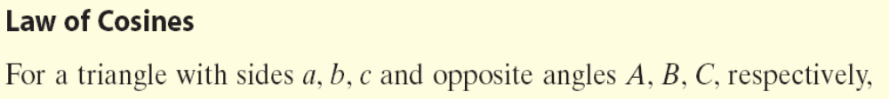
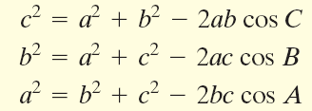
Copyright © 2012 Pearson Education, Inc. Publishing as Prentice Hall.

Slide 3
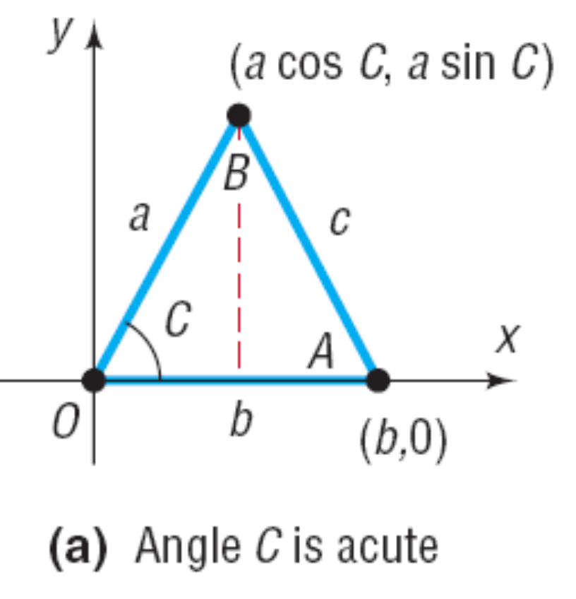
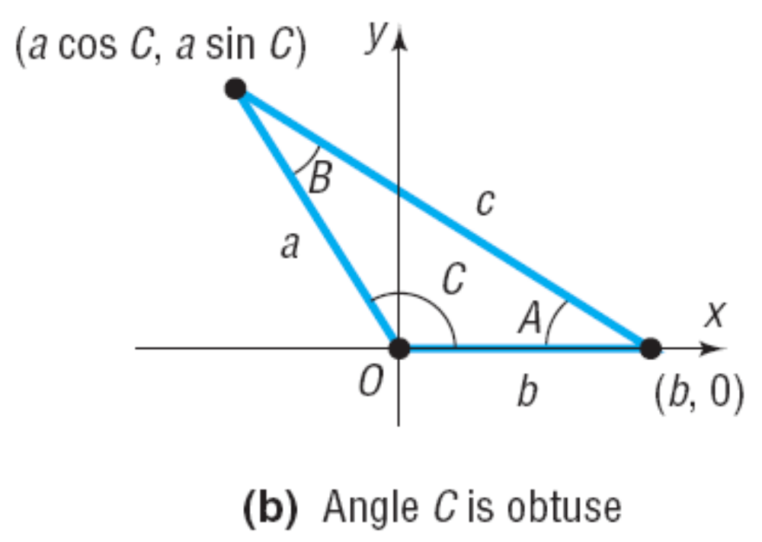
Copyright © 2012 Pearson Education, Inc. Publishing as Prentice Hall.

Slide 4
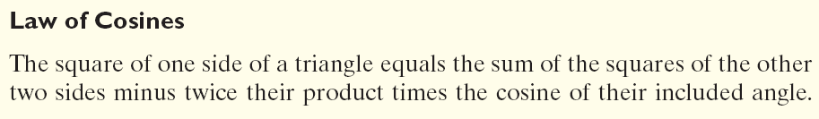
Copyright © 2012 Pearson Education, Inc. Publishing as Prentice Hall.

Slide 5

Copyright © 2012 Pearson Education, Inc. Publishing as Prentice Hall.

Slide 6






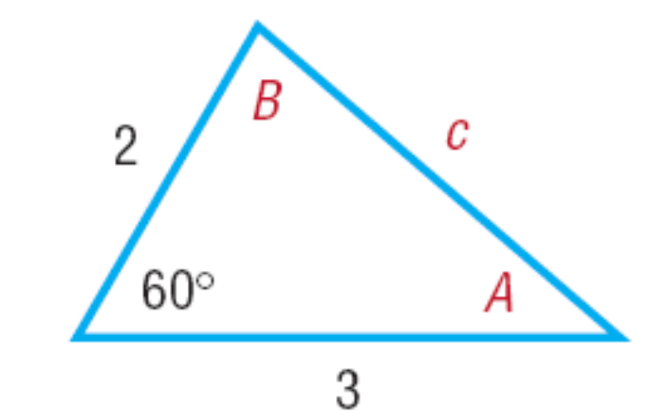




Copyright © 2012 Pearson Education, Inc. Publishing as Prentice Hall.

Slide 7

Copyright © 2012 Pearson Education, Inc. Publishing as Prentice Hall.

Slide 8
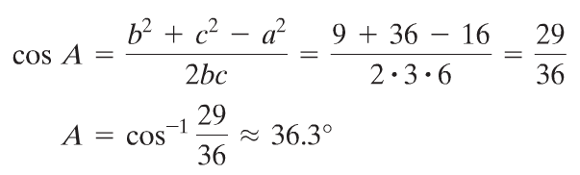


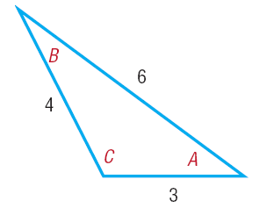



Copyright © 2012 Pearson Education, Inc. Publishing as Prentice Hall.

Slide 9

Copyright © 2012 Pearson Education, Inc. Publishing as Prentice Hall.

Slide 10
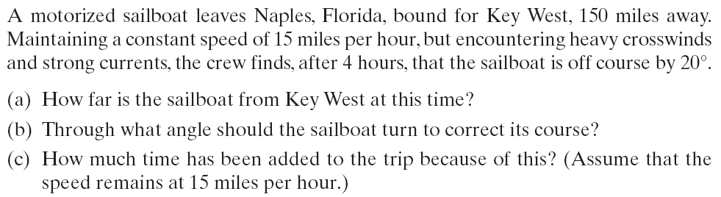
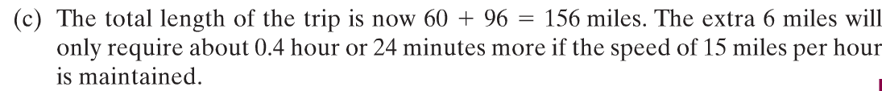
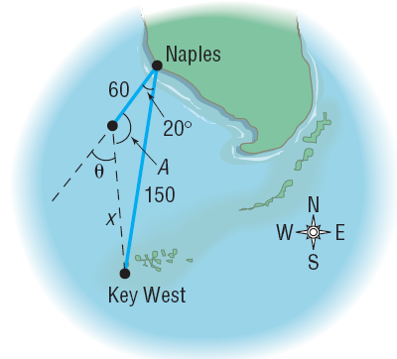




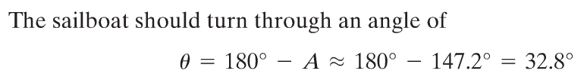
Copyright © 2012 Pearson Education, Inc. Publishing as Prentice Hall.

